Slide 1




Tips and Recommendations
Before You Get Started
  Your Family Experience: consider how to make the event FUN and INFORMATIVE for your families. consider using Scavenger Hunt, Passport, and other ways to engage families while learning about the wonderful world of Title I.
  Cross-Coordination: This continues to be an area of focus. Please consider how you can use other federal funds (Title III, IDEA, Business/Community) to maximize your event.
  Family Engagement supporting documents: Please consider using the Family Engagement documents for the Planning and Post-Event Summary for your reference.
REQUIRED
OPTIONAL
Notes:
When using this template, be sure to change information to be specific to YOUR SCHOOL.
This includes website information, testing dates, School information - the items that should be changed are in RED and you can delete any slides with a Sunshine as they are optional but must keep the Stars they are REQUIRED

Slide 2

DATA SOURCES TO CONSIDER
  COMPREHENSIVE NEEDS ASSESSMENT
  SCHOOL IMPROVEMENT PLAN
  DISTRICT CLIMATE SURVEY (TITLE I ITEMS)
  PM 3 DATA/CONNECTION TO PHASE III
Notes:
Calling out some data sources to get them started…

Slide 3


ALL ABOUT TITLE I
  Title I is the LARGEST Federal Assistance program for our nation’s schools
  The program serves 95 schools in Pinellas County, including students in 38 non-public schools
Notes:
Highlight the Title I Program here in Pinellas County.

Slide 4


Boca Ciega High School
Jennifer Gil
ANNUAL
Title 1 Meeting
September 19, 2025, 6 p.m.
Student Activities Room
Notes:
Evidence: Upload completed presentation and recorded feedback as part of the evidence to support the Annual Meeting Materials. Do not forget the sign-in sheets, and survey/feedback that you receive throughout the meeting. ​
*** CORRECT anything in RED to be your specific school ***

Slide 5

Title I Funding Process
  Federal Government
3. Pinellas County Schools
2. Florida Dept. of Education
4. Boca Ciega High School
Notes:
REQUIRED
The Florida Department of Education receives funds from the federal government. Districts receive Title I funds from Department of Education, and the school district distributes these funds to schools based on the percentage of children eligible for free/reduced price lunch; however, students do not have to be from low-income families to receive help. ​

Slide 6


Title I Supplemental Resources
Definition:
Provided in addition to what is already present or available to complete or enhance it
Notes:
REQUIRED
Title I is supplemental federal funding that provides e​
​
Definition: provided in addition to what is already present or available to complete or enhance it extra academic support and learning opportunities for economically disadvantaged students.

Slide 7
Title I
Schoolwide Planning and Input
FIRST
SECOND
LAST
Seek input from school, family, and community members to determine how Title I funds are used based on a needs assessment.
Please attend online or in-person meetings/trainings and complete surveys to provide input on Title I funding.
All Title I schools must document that parents are involved in the schoolwide planning process.
Notes:
REQUIRED
Evidence for input – input from school can be a survey or notes, which include quotes related to what was shared as feedback AND how this input will be used to inform the PFEP and future engagement activities. ​
​
Evidence of Attendance – please include attendance of DIVERSE stakeholder group/s.

Slide 8
Title I Schoolwide Budget
Boca Ciega High School is provided $140,000 to pay for supplemental resources and programs for increased student achievement.
Instructional Materials and Supplies - $7,858.76
Personnel - $123,193.26
  MTSS Coordinator – Courtney Gicka
    Tracks and monitors student data (grades, attendance, behaviors), implements needed tiered supports for both students and teacher and manages PBIS.
  Student Support Assistant – Novian Smarwt
    Provides support to English 10 classes, serves as a BTG Mentor, and provides coverage for program offices and campus monitors.
Instructional Stipends - $4,191.27
  Compensate teachers for time spent outside of contracted hours for professional development, collaborative planning and/or other tasks that align with SIP goals.
Field Trip Transportation - $3,688.59
Travel Reimbursement - $500
  Attend spring AVID Showcase
Substitutes - $568.12
Notes:
REQUIRED
change all in red

Slide 9


Parent’s Right to Know
Be provided information on your child’s level of achievement on assessments in Reading/Language Arts, Writing, Mathematics and Science
Be notified of non-highly qualified or out-of-field teachers at the school
Be informed if your child is taught by a non-highly qualified teacher for four or more consecutive weeks.
Request and receive information on the qualifications of your child’s teacher and supplemental personnel working with your child

Slide 10
WORKING TOGETHER FOR STUDENT SUCCESS
SCHOOL
TITLE I
PARENT
SCHOOL
School Improvement Plan
Title I Schoolwide Plan
Parent & Family Engagement Plan
School - Parent - Student - Compact
Notes:
REQUIRED
As a Title I parent you have the right to be involved in the development of the following plans and documents for our school which can be found on our website (insert website) to view as well as in the Parent Station located (insert location here). ​
​Our school’s Title I Parent Station is located (insert location or photo of Title I Parent Station- front office and on the webpage). Please include photo as part of the evidence monitoring. ​
​You will find a copy of our School Improvement Plan, Title I Schoolwide Plan, School’s PFEP, the School District’s PFEP, Parent’s Right to Know Memo, Upcoming Events, Compact, (insert other documents at your station)​
​
School Improvement Plan (SIP)​
Parent and Family Engagement Plan ​
Title I Schoolwide Plan ​
School-Parent-Student Compact​

Slide 11



PARENT - SCHOOL - STUDENT
Compact
The purpose of the compact is to foster student achievement. By signing the Parent - School - Student Compact, Boca Ciega High School, teachers, staff, parents and students agree to work together to share the responsibility of helping students meet or exceed state, district and school academic goals.
The Parent - School - Student Compact is updated every year to include parent, student, teacher and staff input. Parent, Student, Teacher and Staff comments are welcome at any time during the year.
Please review and sign your child’s Compact.
Our GOAL is to receive 100% signed compacts!!!
Notes:
REQUIRED
At the elementary level, school compacts are used as a progress monitoring tool through the year during parent teacher conferences.

Slide 12
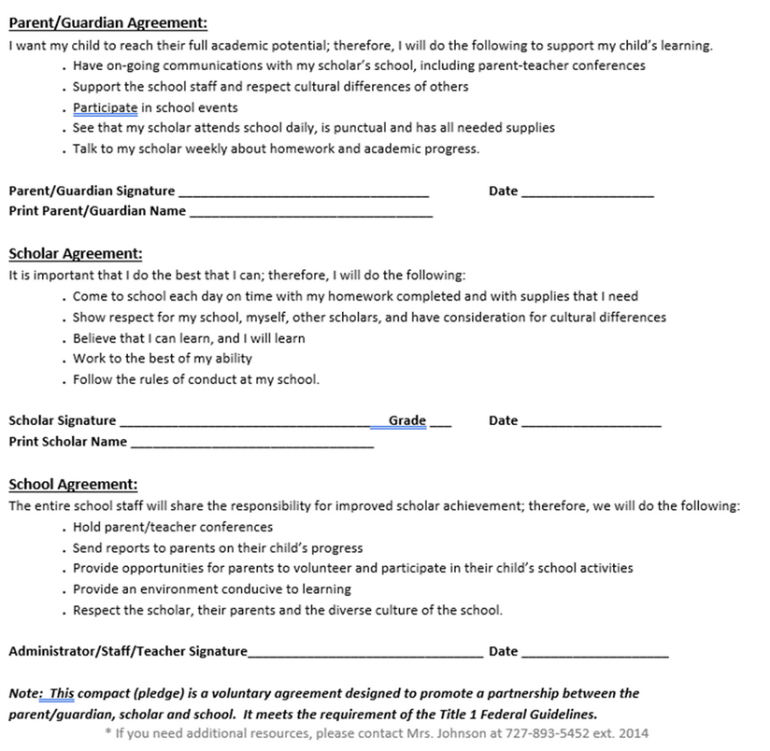
School Compact
Sample School Compact
Notes:
REQUIRED
Please insert an example of your updated school compact. Highlight any things that unique to your school’s compact.

Slide 13


Parent and Family
Engagement Plan
PFEP
The PFEP Sections include information about the following:
•Parent trainings to increase student achievement
•Staff trainings for engaging parents
•Communication methods between home and school
•Flexible meeting times
•Accessibility for parents
•Coordinating with other Federal Programs
Notes:
REQUIRED
Provide information on the specific committees that parents can be involved. Include the purpose, date and time of meetings. ​
Explain the PFEP and its purpose. ​
Consider the evidence related Title I Crate, Sample of Evidence,

Slide 14




Florida Benchmark for Excellent Student Thinking Standards (B.E.S.T). You may read more information by visiting, www.fldoe.org
Notes:
REQUIRED
All curriculum, instruction and assessments are based on student-centered expectations.

Slide 15



School’s Curriculum
Florida Benchmark for Excellent Student Thinking Standards (B.E.S.T) form the framework of everything taught at school.
Core Curriculum:
English Language Arts (ELA) Grades 9 & 10 Mathematics (Alg. 1 & Geo.) Grades 9-11
Biology Grade 9
US History Grade 11
Notes:
REQUIRED
This slide is optional if this will be discussed with classroom teacher ​
School’s Curriculum​
Describe and explain the curriculum (Specific names of texts)​

Slide 16


SCHOOL REPORT CARDS:
•School Grade and Overview
•Population and Enrollment
•Assessments- Academic Achievement, Growth, and Population
•Assessments -English Language Learners
•Graduation and Beyond
•Educator Qualifications and Equity
•Long-Term Goals and Interim Progress
•Accelerated Course Enrollment
•Per-Pupil Expenditures
•National Data
Available Online at School Report Cards:
•School Grade and Overview
•Population and Enrollment
•Assessments- Academic Achievement, Growth, and Population
•Assessments -English Language Learners
•Graduation and Beyond
•Educator Qualifications and Equity
•Long-Term Goals and Interim Progress
•Accelerated Course Enrollment
•Per-Pupil Expenditures
•National Data
Available online at Dept of Education OR Front Office

Slide 17
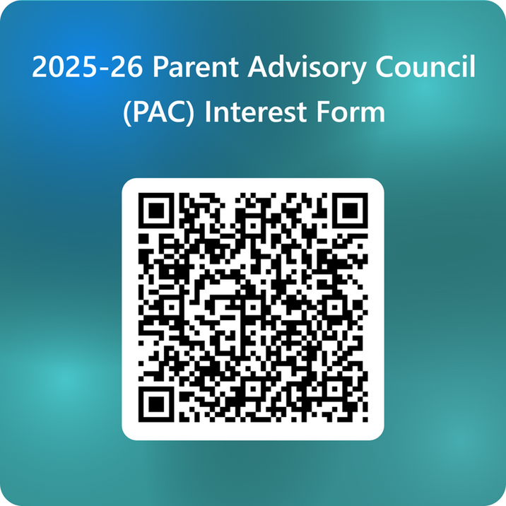
Parent Advisory Council
(PAC)
•The district has a Parent and Family Engagement Plan. The summary of the plan is in the Title I School & Family Partnership Overview.
•You may access the full plan at www.pcsb.org/titleone
•The Parent Advisory Council (PAC) is responsible for reviewing and revising the District PFEP.
•PAC will meet virtually or in-person with the district’s Title I Staff.
•Each school is committed to having at least one member representing our school please notify, INSERT contact person
Notes:
REQUIRED
Please add your PAC representative in slide and share with your Title I Specialist. ​
​https://forms.office.com/Pages/ResponsePage.aspx?id=BZM8c9c5GkaGb_3ye_PH_ywWjljlMQdDv9wc58mKxfhUMlBCTlJTQkVCUkNDTjNIUTBaQTZSSDI1My4u

Slide 18

Insert upcoming parent and family events, SAC/PTA meetings, Parent Academy, etc.
Notes:
OPTIONAL
Do you have a calendar of key events that are included in your PFEP. ​
​
Evidence – Consider this as evidence to include to support Family Engagement.

Slide 19



Additional Resources
Learning at Home Family Resources -https://www.pcsb.org/Page/32836​
​
Volunteer in a Pinellas County School - https://www.pcsb.org/Page/459​
​
Parent Academy POWER HOURS Webinars - https://www.pcsb.org/Page/26534​
​
Partnerships - https://www.pcsb.org/Page/418

Slide 20

THANK YOU

Slide 21




School Phone Numberr
Website
School address

Slide 22
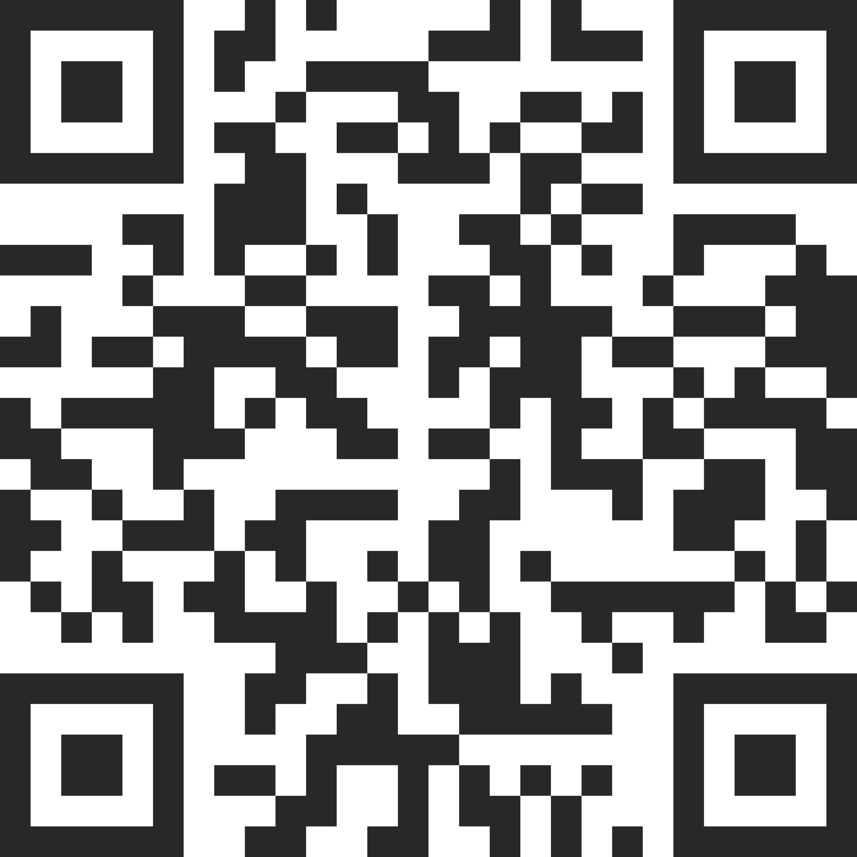
Insert QR Code below with survey!
See notes for details.
Your Feedback is Greatly Appreciated!!!
Notes:
OPTIONAL
Please duplicate Microsoft Forms provided or create school survey. To generate a QR code hover over your school’s survey and right click. Create QR code for this page will be an option.​
​
https://forms.office.com/Pages/ResponsePage.aspx?id=BZM8c9c5GkaGb_3ye_PH_ywWjljlMQdDv9wc58mKxfhUNUlRMzRNRDRTVEdXS1JCUzZMQ01MR0VXTy4u

